Slide 1
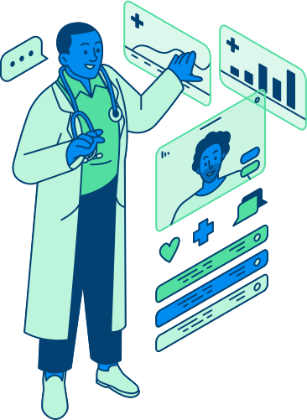
MULTIPLE DISEASE PREDICTION WEB APP
KSHITIZ RAJ 2005457
SAMEER SHEKHAR 2005960
SRISHTY SINGH 2005972
YASHASHWI RAJ 2005980

Slide 2

INTRODUCTION
MULTIPLE DISEASE PREDICTION SYSTEM
Based on entered symptoms and medical history, our web application uses machine learning algorithms to detect numerous diseases. Our platform provides individualised and precise predictions for a variety of medical disorders by analysing big datasets and utilising cutting-edge predictive models. With the use of this technology, users can get early detection and take precautions to keep their health. Our objective is to build a tool for disease prediction that is simple to use and widely available in order to improve healthcare outcomes for people all around the world.

Slide 3

ALGORITHMS USED
Logistic Regression
Support Vector Mchine

Slide 4

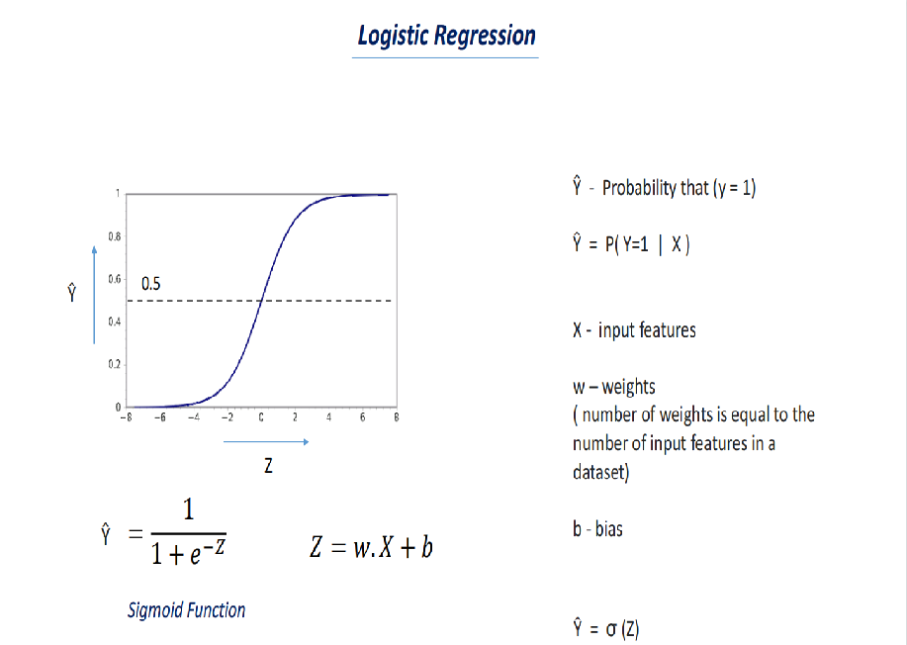
LOGISTIC REGRESSION
Binary classification challenges are handled by the machine learning method logistic regression. It operates by predicting the probability of an event occurring based on the input features and fitting a logistic function to the input data. The method is widely utilised in many different industries, including spam filtering, credit scoring, and medical diagnosis. Because it is simple to use and interpret, logistic regression is frequently chosen for predictive modelling. Its performance may be constrained in some cases, though, because it presumes a linear relationship between the input features and the output variable..

Slide 5
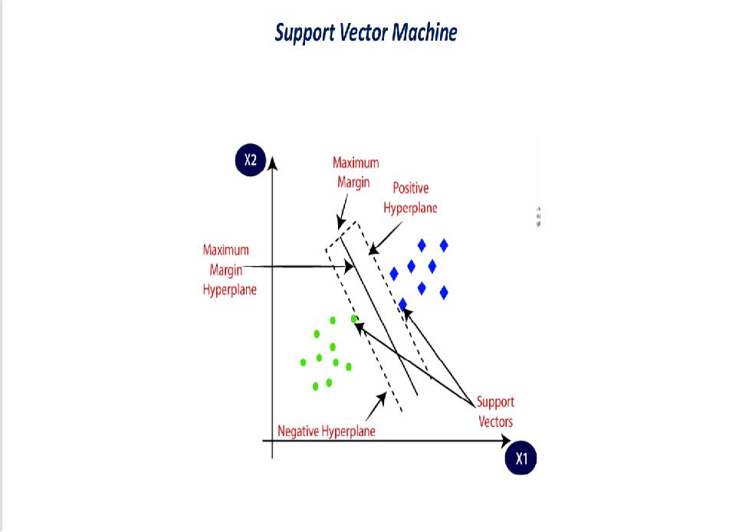
SUPPORT VECTOR MACHINE
A common machine learning approach for classification and regression tasks is called Support Vector Machine (SVM). In order to categorise data points into multiple classes while maximising the margin between the classes, the best hyperplane must be found. SVMs are capable of managing both linear and nonlinear issues and are efficient when dealing with high-dimensional datasets. The approach is frequently utilised in several disciplines, including bioinformatics, text classification, and image classification.

Slide 6
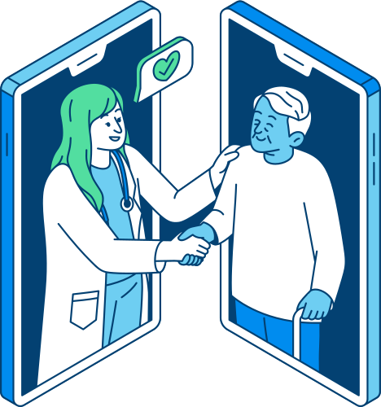
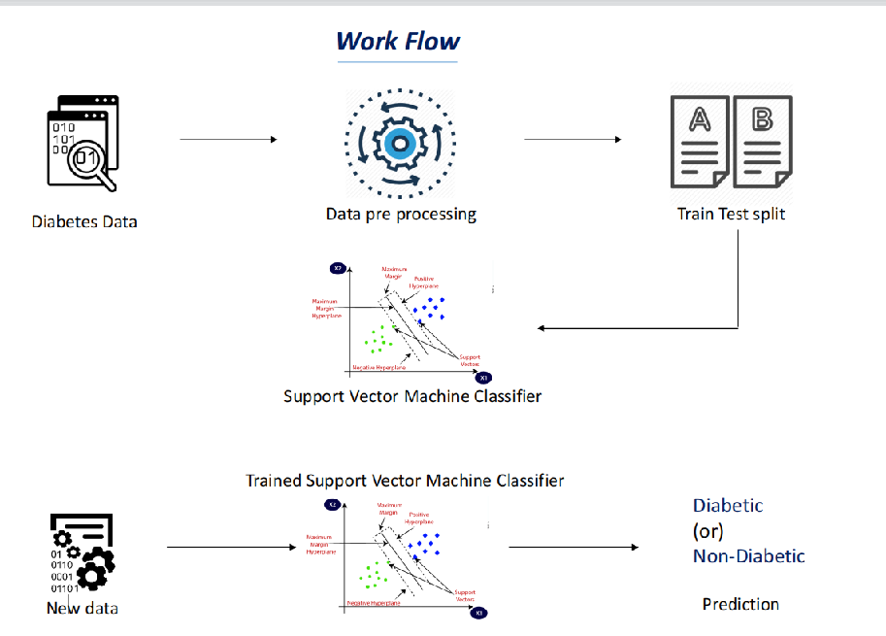
DIABETES PREDICTION MODEL
Utilising machine learning algorithms, our diabetes prediction model examines a variety of medical indicators to determine the likelihood that a patient will develop diabetes. Our model's ability to make predictions for novel cases and properly identify trends is enhanced by training on huge datasets. Improved health outcomes can result from using this tool to help healthcare professionals identify and treat diabetes early. We want to increase accessibility and reliability for people all across the world when it comes to diabetes prediction by utilising the power of ML.

Slide 7
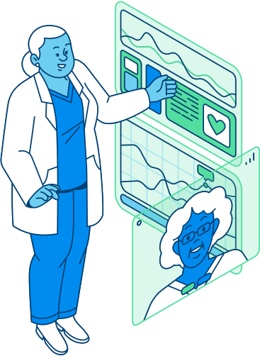
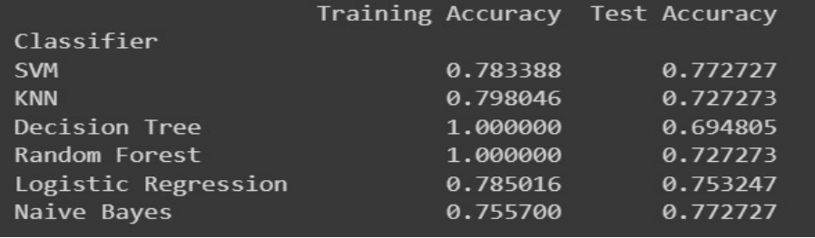
WHY SVM?
Overfitting: Decision Tree and Random Forest show 100% training accuracy, which could indicate overfitting.
Generalization: SVM, Logistic Regression, and Naive Bayes seem to have a better balance between training and test accuracy.
SVM good choice due to its decent accuracy on both the training and test sets, indicating good generalization.

Slide 8
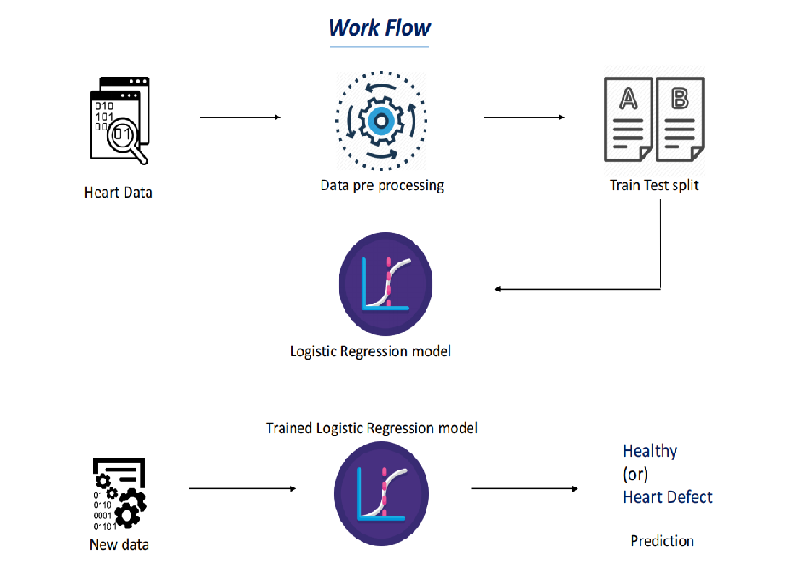
HEART DISEASE PREDICTION MODEL
The risk that a person will have heart disease is predicted using our Heart Disease Prediction Model, a machine learning tool. Our model can recognise patterns and provide precise predictions for novel scenarios by being trained on vast datasets. This technique can help medical professionals identify and treat cardiac problems earlier, which will eventually improve patient outcomes. We want to increase global accessibility and reliability of heart disease prediction by utilising the potential of ML.

Slide 9
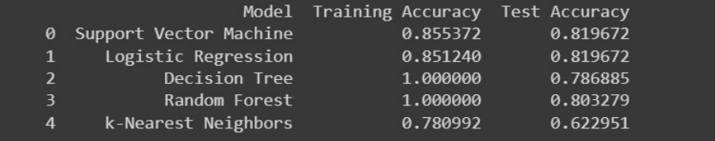
WHY LOGISTIC
REGRESSION?
Decision Tree and Random Forest achieve perfect accuracy on the training set, which may suggest overfitting.
k-NN has lower accuracy compared to other models, indicating that it might not be the best choice for this dataset.
But we are primarily concerned with accuracy, SVM or Logistic Regression may be good choices.
Also interpretability is crucial, Logistic Regression is preferable.

Slide 10
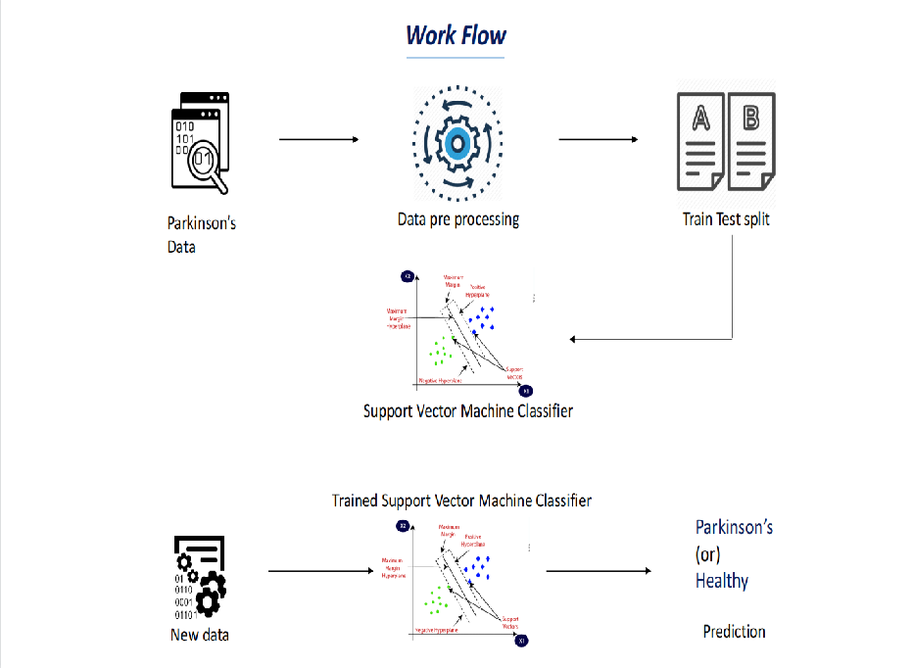
PARKINSON’S DISEASE PREDICTION
Our Parkinson's Disease Prediction Model is a machine learning tool that assesses numerous health indicators to forecast the probability that a person will develop Parkinson's disease. Our model can find trends and provide precise predictions for novel scenarios by being trained on vast datasets. This technique can help medical professionals identify Parkinson's disease early and begin treatment, which will ultimately improve patient outcomes. We want to increase accessibility and reliability of Parkinson's disease prediction for people all around the world by utilising the power of ML.

Slide 11
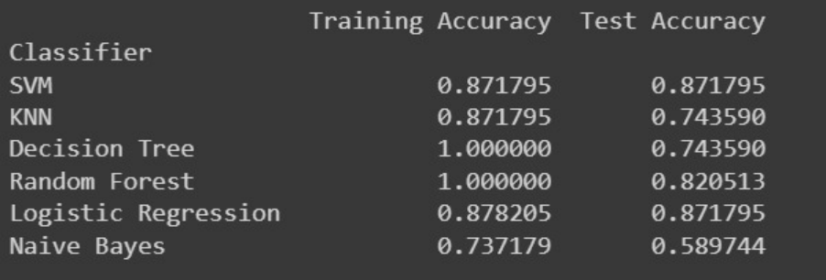
WHY SVM?
Overfitting: Decision Tree and Random Forest still exhibit 100% training accuracy, suggesting potential overfitting.
Consistent Performance: SVM, KNN, and Logistic Regression show relatively consistent performance between training and test sets, indicating good generalization.
SVM and Logistic Regression seem to be strong contenders.
As per our research SVM is best for parkinsion prediction so we used it

Slide 12
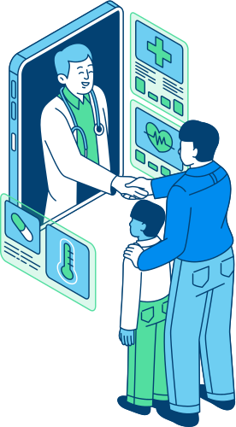
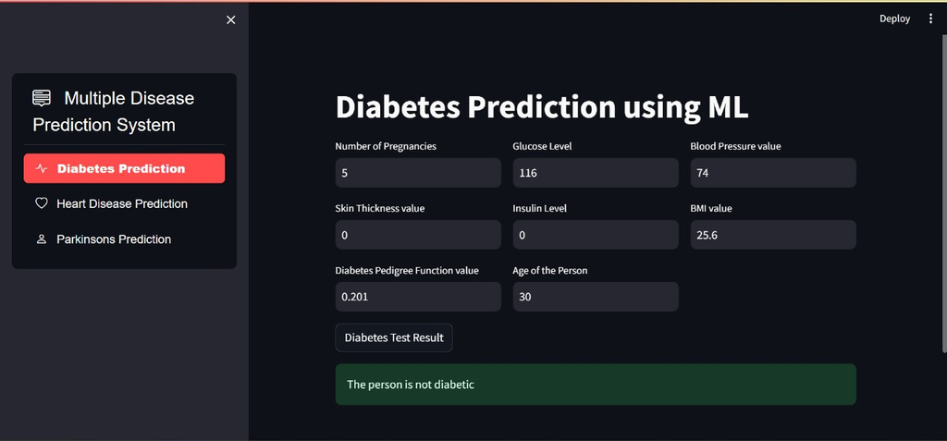
DEPLOYING THE WEB APP
A simple and effective technique for deploying web apps is Streamlit. We first need to develop a Streamlit app with the required machine learning code and web interface components in order to launch our Multiple Disease Prediction Model using ML on Streamlit. Then, by adhering to the appropriate deployment procedures, we can deploy the app on a hosting platform like Heroku or AWS. Once set up, users can use the online app and enter their medical information and symptoms to get individualised and precise disease forecasts.

Slide 13



CONCLUSION
In conclusion, the machine learning (ML) model created for forecasting numerous diseases, including diabetes, Parkinson's disease, and heart disease, has tremendous promise for the healthcare industry. The model's excellent accuracy rates show that it has the potential to help medical practitioners identify these diseases early and take preventative measures. The study also emphasises how crucial it is for experts in the medical and technology disciplines to work together to leverage machine learning's potential for solving difficult health problems. This model has the potential to contribute to more precise and effective disease diagnosis and management, ultimately enhancing patient outcomes and quality of life.

Slide 14

WEB APP LINK
https://multi-disease-predictor-by-sameer-95ed2bebtpvs7uddsphdhe.streamlit.app/

Slide 15

THANK YOU!

